Slide 1
Azure Queues & WebJobs
Tom Straub

Slide 2
Azure Storage Queues

Slide 3
What are Azure Queues?
Are part of the Azure storage infrastructure
Feature a simple REST-based Get/Put/Peek interface
Providing reliable, persistent messaging within and between services.

Slide 4
How can they be used?
Creating a backlog of work to process asynchronously
Passing messages from an Azure web role to an Azure worker role
Or a WebJob!
Allow for better scaling

Slide 5
WebJobs

Slide 6
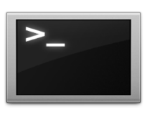
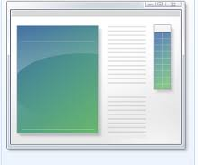
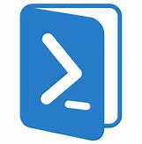
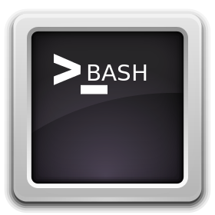

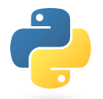
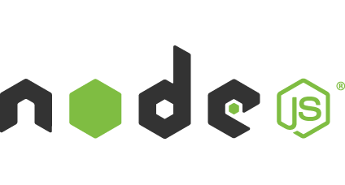
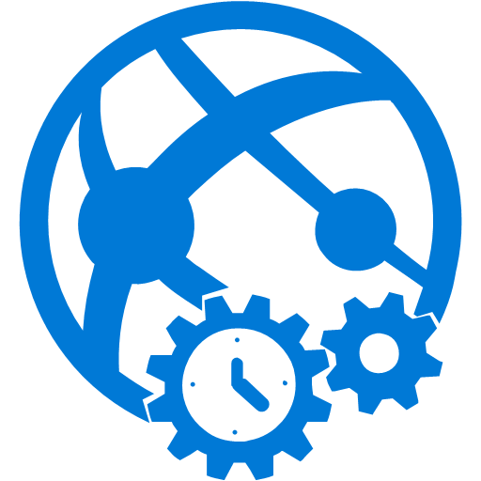
Light-weight CPU Intensive Tasks
run.cmd, run.bat
run.exe
run.ps1
run.sh
run.php
run.py
run.js
Job Type:
On-Demand, Scheduled, Continuous
Scale:
Singleton, Multi-instance
WebJobs SDK Feature:
BlobTrigger, TableTrigger, QueueTrigger, ServicebusTrigger
Deployment:
Portal, Visual Studio, CLI, Git

Slide 7

WebJobs
Web App

Slide 8
WebJobs
Web App

Slide 9
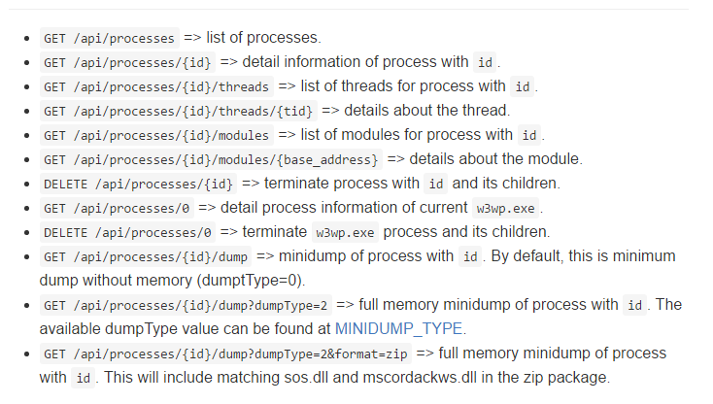

Queues + Webjobs
Automatic Poison Queue
Easy Storage Interation
Logging built in
Auditing tracks

Slide 10
Lab: WebJobs

Slide 11
Q&A

Slide 12


Get started
Visit azure.microsoft.com

